Slide 1
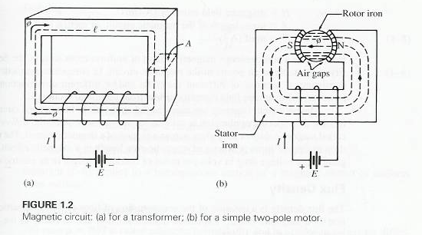
Magnetic Circuits
amrita_university

Slide 2
Magnetic Circuit Definitions
Magnetomotive Force
  The “driving force” that causes a magnetic field
  Symbol, F
  Definition, F = NI
  Units, Ampere-turns, (A-t)
amrita_university

Slide 3
Magnetic Circuit Definitions
Magnetic Field Intensity
  mmf gradient, or mmf per unit length
  Symbol, H
  Definition, H = F/l = NI/l
  Units, (A-t/m)
amrita_university

Slide 4
Magnetic Circuit Definitions
Flux Density
  The concentration of the lines of force in a magnetic circuit
  Symbol, B
  Definition, B = Φ/A
  Units, (Wb/m²), or T (Tesla)
amrita_university

Slide 5
Magnetic Circuit Definitions
Reluctance
  The measure of “opposition” the magnetic circuit offers to the flux
  The analog of Resistance in an electrical circuit
  Symbol, R
  Definition, R = F/Φ
  Units, (A-t/Wb)
amrita_university

Slide 6
Magnetic Circuit Definitions
Permeability
  Relates flux density and field intensity
  Symbol, μ
  Definition, μ = B/H
  Units, (Wb/A-t-m)
amrita_university

Slide 7
Magnetic Circuit Definitions
Permeability of free space (air)
  Symbol, μ₀
  μ₀ = 4πx10⁻⁷ Wb/A-t-m
amrita_university

Slide 8
Magnetic Circuit Definitions
Relative Permeability
  Compares permeability of material with the permeability of free space (air)
  Symbol, μ_{r}
  μ_{r} = μ/μ₀ Dimensionless
amrita_university

Slide 9
A coil of 200 turns is wound uniformly over a wooden ring having a
mean circumference of 600 mm and a uniform cross-sectional area
of 500 mm2. If the current through the coil is 4.0 A, calculate
(a) the magnetic field strength;
(b) the flux density;
(c) the total flux.
Mean circumference = 600 mm = 0.6 m.
∴ H = 4 × 200/0.6 = 1333.33A/m
(b) From expression :
Flux density = μ₀H = 4π × 10−7 × 1333.33
= 0.001 675 T ≡ 1680 μT
(c) Cross-sectional area = 500 mm² = 500 × 10−6 m²
∴ Total flux = 1675 [μT] × (500 × 10−6) [m²] ≡ 0.838 μWb
Reluctance
R = l/ (μ *A)
amrita_university

